Slide 1
Chapter 11
Time and Global States

Slide 2
Chapter 11 Time and Global States
  Introduction
  Clocks, events and process states
  Synchronizing physical clocks
  Logical time and logical clocks
  Global states
  Distributed debugging
  Summary

Slide 3
11.1 Introduction
Importance of time in distributed systems
  A quantity to timestamp events accurately
    To know what time a particular event occurs
    i.e. Recording when an e-commerce transaction occurs
  A synchronization source for several distributed algorithms
    To maintain consistency of distributed data
    i.e. Eliminating duplicate updates
  A timing source for multiple events
    To provide relative order of two events
    i.e. Ensuring the order of cause and effect
Clocks in computers to establish
  Time at which an event occurred
  Duration of an event or interval between two events
  Sequence of a series of events or the order in which events occurred

Slide 4
11.2 Clocks, Events and Process States
A distributed system consists of a collection P of
N processes p_{i}, i = 1,2,… N
– Each process
p_{i} has a state s_{i} consisting of its variables
(which it transforms as it executes)
Processes communicate only by messages (via a network)
  Actions of processes: Send, Receive, change own state
Event: the occurrence of a single action that a process carries out as it executes
Events at a single process p_{i}, can be placed in a total ordering
denoted by the relation →_{i} between the events. i.e.
  e →_{i  }e’ if and only if  event e occurs before event e’ at process p_{i}
A history of process p_{i:} is a series of events ordered by →_{i}
  history(p_{i}) = h_{i} = <e ⁰, e ¹, e ², …>
i i i

Slide 5
Clocks
To timestamp events, use the computer’s clock
At real time, t, the OS reads the time
on the
computer’s hardware clock H_{i}(t)
It calculates the time on its software clock C_{i}(t)=
αH_{i}(t) + β
  e.g. a 64 bit value giving nanoseconds since some base time
  Clock resolution: period between updates of the clock value
In general, the clock is not completely accurate
  but if C_{i} behaves well enough, it can be used to timestamp events at p_{i}

Slide 6
Skew between computer clocks in a distributed system
Network
Figure 11.1
Computer clocks are not generally in perfect agreement
Clock skew: the difference between the times on two clocks (at any instant)
Computer clocks use crystal-based clocks that are subject to physical variations
  Clock drift: they count time at different rates and so diverge (frequencies of oscillation differ)
  Clock drift rate: the difference per unit of time from some ideal reference clock
  Ordinary quartz clocks drift by about 1 sec in 11-12 days. (10⁻⁶ secs/sec).
  High precision quartz clocks drift rate is about 10⁻⁷ or 10⁻⁸ secs/sec

Slide 7
Coordinated Universal Time (UTC)
UTC is an international standard for time keeping
  It is based on atomic time, but occasionally adjusted to astronomical time
  International Atomic Time is based on very accurate physical clocks (drift rate 10⁻¹³)
It is broadcast from radio stations on land and satellite (e.g. GPS)
Computers with receivers can synchronize their clocks With these timing signals (by requesting time from GPS/UTC source)
  Signals from land-based stations are accurate to about 0.1-10 millisecond
  Signals from GPS are accurate to about 1 microsecond

Slide 8
11.3 Synchronizing physical clocks
It is necessary to synchronize the processes clocks Ci with an authoritative ,external source of time,this is external synchronization and if the clocks Ci are synchronised with one another this is internal sunchronization.
Two models of synchronization
External synchronization: for a synchronization bound D>0,a computer’s clock C_{i} is synchronized with an external authoritative time source S, so that:
  |S(t) - C_{i}(t)| < D for i = 1, 2, … N over an interval, I of real time
  The clocks C_{i} are accurate to within the bound D.
Internal synchronization:the clocks of a pair of computers are synchronized with one another so that:
  | C_{t}(t) - C_{j}(t)| < D for i, j= 1, 2, … N over an interval, I of real time
  The clocks C_{i} agree within the bound D.

Slide 9
Internally synchronized clocks are not necessarily externally synchronized, as they may drift collectively
  if the set of processes P is synchronized externally within a bound D, it is also internally synchronized within bound 2D (worst case polarity)

Slide 10
Clock correctness
Correct clock: a hardware clock H is said to be correct if its drift rate is within a bound ρ > 0 (e.g. 10⁻⁶ secs/ sec)
This means that the error in measuring the interval between real times t and
t’ is bounded:
– (1 - ρ )(t’ - t) ≤ H(t’) - H(t) ≤ (1 + ρ )(t’ - t) (……..where t’>t)
  Which forbids jumps in time readings of hardware clocks
Clock monotonicity: weaker condition of correctness
– t' > t ⇒ C(t’) > C(t)
  e.g. required by Unix make
  A hardware clock that runs fast can achieve monotonicity by adjusting the values of α  and β such that C_{i}(t)= αH_{i}(t) + β
Faulty clock: a clock not keeping its correctness condition
  crash failure - a clock stops ticking
  arbitrary failure - any other failure
    e.g. jumps in time; Y2K bug

Slide 11
11.3.1 Synchronization in a synchronous system
A synchronous distributed system is one in which the following bounds are defined
the time to execute each step of a process has known lower and upper bounds
each message transmitted over a channel is received within a known
bounded time (min and max)
each process has a local clock whose drift rate from real time has a known bound
Internal synchronization in a synchronous system
  One process p₁ sends its local time t to process p₂ in a message m
  p₂ could set its clock to t + T_{trans} where T_{trans} is the time to transmit m
  T_{trans} is unknown but min ≤ T_{trans} ≤ max
  uncertainty u = max-min. Set clock to t + (max - min)/2 then skew ≤ u/2
10

Slide 12
11.3.2 Cristian’s method for an asynchronous system
A time server S receives signals from a UTC source
– Process p requests time in m_{r} and receives t in m_{t} from S
p sets its clock to t + T_{round}/2
Accuracy ± (T_{round}/2 - min) :
T
is the round trip time recorded by p
round
min is an estimated minimum round trip time
because the earliest time S puts t in message m_{t} was min after p dispatched m_{r}
the latest time was min before m_{t} arrived at p
the time by S’s clock when m_{t} arrives is in the range [t+min, t + T_{round} - min]
Max-Min so,t+Tround-min-t-min the width of the range is T_{round} - 2min
m_{r}
m _{t}
Figure 11.2
p
Time server,S
11

Slide 13
11.3.3 The Berkeley algorithm
Problem with Cristian’s algorithm
a single time server might fail, so they suggest the synchronized servers
it does not deal with faulty servers
Berkeley algorithm (also 1989)
use of a group of
An algorithm for internal synchronization of a group of computers
A master polls to collect clock values from the others (slaves)
The master uses round trip times to estimate the slaves’ clock values
It takes an average (eliminating any above some average round trip time or with faulty clocks)
It sends the required adjustment to the slaves (better than sending the time which depends on the round trip time)
Measurements
  15 computers, clock synchronization 20-25 millisecs drift rate < 2x10⁻⁵
  If master fails, can elect a new master to take over (not in bounded time)

Slide 14
NTP - Network Time Protocol

Slide 15
Historical facts
Developed in 1985 by David Mills at the University of Delaware, USA.
David is still maintaining NTP.
NTP is one of the oldest Internet protocols still in use.
Latest version is NTP version 4 (version 5 is under development)

Slide 16
Differences to Cristian‘s method and the Berkley algorithm
Cristian‘s method(CM) and the Berkley algorithm(BA) are both designed for primarily use in intranets.
The Network Time Protocol was designed for use in the Internet (or other unreliable networks) right up from the start.
CM and BA both synchronize against one time server.
NTP synchronizes against many time servers.

Slide 17
Technical facts
NTP is an application layer protocol
  Default port number 123
  Uses standard UDP Internet transport protocol
Timestamps are used in messages
  Timestamps counted as seconds
  64bit-wide seconds field (NTP version 4)
  NTP version 5 might have 128bit-wide seconds field
Accuracy
  approx. 200µs over LAN
  approx. 10ms over Internet

Slide 18
Design aims of NTP
Adjust system clock as close to UTC as possible over the Internet. (statistic techniques for filtering timing data for the quality of timing data b/w servers)
Handle bad connectivity. (redundant servers & redundant paths b/w servers, reconfigurable servers)
Enable sufficiently frequently resynchronizations. (scaling well on large numbers of clients and servers)
Security. (distrust server’s time, authentication techniques to check the timing data originated from trusted sources)

Slide 19
Hierarchical structure
The NTP service is provided by a network of servers located across the Internet.
Primary servers are connected directly to a time source. (e.g. a radio clock receiving UTC, GPS).
Secondary servers are synchronized with primary servers.
The servers are connected in a logical hierarchy called a synchronization subnet.

Slide 20
Synchronization subnet
Each level of the synchronization subnet is called stratum. (e.g. primary servers are stratum 1, secondary stratum 2 and so on)
Lowest-level (leaf) servers execute in users‘ workstations. (e.g. ntp under Linux)
Servers with high stratum numbers are liable to have less accurate clocks than those with lower stratum numbers.
The synchronization subnet can reconfigure as servers become unreachable or failures occur.

Slide 21
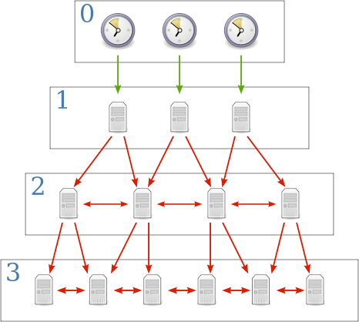
Example: strata
Source: http://upload.wikimedia.org/wikipedia/commons/c/c9/Network_Time_Protocol_servers_and_clients.svg

Slide 22
Server synchronization
There are three possible synchronization modes:
  multicast (sometimes called broadcast)
  procedure-call (sometimes called client)
  symmetric (sometimes called peer)

Slide 23
multicast mode
One or more servers periodically multicasts the time to the servers in the network.
Receivers set their clock assuming a small delay.
Receivers don‘t reply.
Problem:
  Relative low accuracy.
  Due to hardware limitations this mode only works in IP multicast enabled networks like LAN.

Slide 24
procedure-call mode
One server accepts requests from other computers.
The server replies with its timestamp(current clock reading).
Higher accuracy.

Slide 25
symmetric mode
Intended to be used on higher levels of the synchronization subnet.
A pair of servers exchange messages to improve the accuracy of their synchronization over time. (reduction of the synchronization dispersion)
Highest accuracy.

Slide 26
Example: message exchange
Let A and B be NTP servers exchanging messages with each other.
m is the message A sends to B.
m‘ is the message B replies to A.
m and m‘ form a pair of messages.
T₁ to T₄ are timestamps

Slide 27
Example: message exchange b/w a pair of NTP peer
Server B T₂ T₃
m
m‘
Server A T₁ T₄

Slide 28
How NTP works
NTP calculates an offset o_{j} and a delay d_{j}
– o_{j} = T(B) - T(A) = [(T₂-T₁) + (T₄-T₃)]/2
– d_{j} = T(ABA) = (T₄-T₁) - (T₃-T₂)
As the transmission times of m and m‘ are allways ≥ 0 the real offset o is
– o_{j} - d_{j}/2 ≤ o ≤ o_{j} + d_{j}/2

Slide 29
How NTP works ff
NTP uses Marzullo's algorithm to filter the offset o out of successive pairs <o_{j},d_{j}>.
NTP calculates the filter dispersion ε.
High ε indicates unreliable data.
At the end <o_{j},d_{j}> with smallest d_{j} is choosen.

Slide 30
How NTP works ff
To achieve higher accuracy an NTP server contacts several peers.
NTP applies a peer-selection algorithm.
This examines which peer has the most reliable value.
The server changes its primary synchronization peer to the most reliable one.

Slide 31
How NTP works ff
Lower stratum numbers are more favoured as they are closer to the primary time sources.
NTP modifies the local clock frequency to reduce its drift rate.

Slide 32
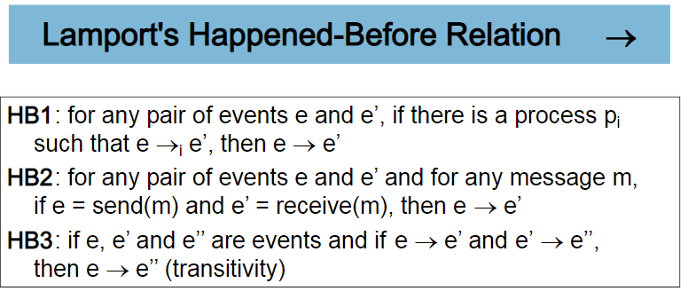
11.4 Logical time and logical clocks
Instead of synchronizing clocks, event ordering can be used
  If two events occurred at the same process pi (i = 1, 2, … N) then they occurred in the order observed by pi, that is order →_{i}
  when a message, m is sent between two processes, send(m) happened before receive(m), send(m) receive(m)
Lamport[1978]generalized these two relationships into the

Slide 33
Figure 11.5 Events occurring at three processes
p₁
a
b
m₁
p₂
Physical time
c
d
m₂
p₃
e f
HB1: a→b, c→d, e→f
HB2: b→c, d→f
HB3: a→b→c→d→f
a||e: a and e are concurrent (neither a→e nor e→a)
18

Slide 34
Lamport’s logical clocks
Each process p_{i} has a logical clock L_{i}
  a monotonically increasing software counter
  not related to a physical clock
Apply Lamport timestamps to events with happened-before relation
  LC1: L_{i} is incremented by 1 before each event at process Pi:Li:=Li+1
  LC2:
    when process p_{i} sends message m, it piggybacks t =L_{i}
    when p_{j} receives (m,t), it sets L_{j} := max(L_{j}, t) and applies LC1 before time stamping the event receive (m)
e →e’ implies L(e)<L(e’), but L(e)<L(e') does not imply e→e’
1 2
L(b)>L(e)
but b||e
p₁
a
b
m₁
3
4
Physical time
p₂
c
d
m₂
1
5
p₃
Figure 11.6
e
f
19

Slide 35
Totally ordered logical clocks
Some pairs of distinct events, generated by different processes, may have numerically identical Lamport timestamps
– Different processes may have same Lamport time
Totally ordered logical clocks
– If e is an event occurring at
p_{i} T_{i},
with local timestamp and
if e’ is an event occurring at p_{j} with local timestamp T_{j}
Define global logical timestamps for the events to be (T_{i}, i ) and (T_{j}, j)
Define (T_{i}, i ) < (T_{j}, j ) iff
  T_{i} < T_{j} or
  T_{i} = T_{j} and i < j
No general physical significance since process identifiers are arbitrary

Slide 36
Vector clocks
Shortcoming of Lamport clocks:
L(e) < L(e') doesn't imply e → e'
Vector clock: an array of N integers for a system of N processes
  Each process keeps its own vector clock V_{i} to timestamp local events
  Piggyback vector timestamps on messages
Rules for updating vector clocks:
  For a vector clock Vi, Vi[ i] is the number of events that pi has timestamped
  Vi[ j] ( j≠ i) is the number of events at p_{j} that p_{i} has been affected by
  VC1: Initially, V_{i}[ j ] := 0 for p_{i}, j=1.. N (N processes)
  VC2: before p_{i} timestamps an event, V_{i}[ i ] := V_{i}[ i ]+1
  VC3: p_{i} piggybacks t = V_{i} on every message it sends
  VC4: when p_{i} receives a timestamp t, it sets V_{i}[ j ] := max(V_{i}[ j],t[ j]) for j=1..N (merge operation)

Slide 37
Figure 11.7 Vector timestamps for events shown in Figure 11.5
(1,0,0) (2,0,0)
p₁
a
b
m ₁
(2,1,0)
(2,2,0)
Physical time
p₂
c
d
m ₂
(0,0,1)
(2,2,2)
p₃
e
f
Compare vector timestamps
  V=V’ iff V[j] = V’[j] for j=1..N
  V<=V’ iff V[j] <= V’[j] for j=1..N
  V<V’ iff V<= V’ ^ V!=V’
Figure 11.7 shows
  a→f since V(a) < V(f)
  c || e since neither V(c) <= V(e) nor V(e) <= V(c)

Slide 38
11.5 Global states
How do we find out if a particular property is true in a distributed system? For examples, we will look at:
  Distributed Garbage Collection
  Deadlock Detection
  Termination Detection
– Debugging
p₁
p ₂
object reference
message
a. Garbage collection
garbage object
p₁
wait-for
p ₂
b. Deadlock
wait-for
Figure 11.8 Detecting
p₁
p ₂
global properties
activate
c. Termination
passive
passive

Slide 39
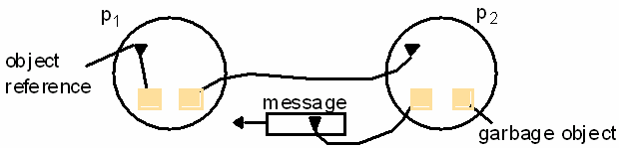
Distributed Garbage Collection
Objects are identified as garbage when there are no longer any references to them in the system
Garbage collection reclaims memory used by those objects
In figure 11.8a, process p₂ has two objects that do not have any references to other objects, but one object does have a reference to a message in transit. It is not garbage, but the other p₂ object is
Thus we must consider communication channels as well as object references to determine unreferenced objects

Slide 40
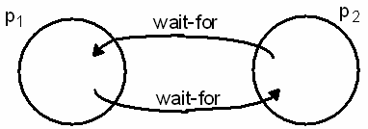
Deadlock Detection
A distributed deadlock occurs when each of a collection of processes waits for another process to send it a message, and there is a cycle in the graph of the waits-for relationship
In figure 11.8b, both p₁ and p₂ wait for a message from the other, so both are blocked and the system cannot continue

Slide 41
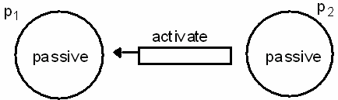
Termination Detection
It is
difficult to tell whether a distributed algorithm has
terminated. It is not enough to detect whether each process has halted
In figure 11.8c, both processes are in passive mode, but there is an activation request in the network
Termination detection examines multiple states like deadlock detection, except that a deadlock may affect only a portion of the processes involved, while termination detection must ensure that all of the processes have completed

Slide 42
Distributed Debugging
Distributed processes are complex to debug.
One of many
possible problems is that consistency restraints must be evaluated for simultaneous attribute values in multiple processes at different instants of time (Section 11.6)
All four of the distributed problems discussed in this section have particular solutions, but all of them also illustrate the need to observe global states. We will now look at a general approach to observing global states

Slide 43
11.5.1 Global states and consistent cuts
State of collection of processes and state of communication channels is called global states
Without global time identified by perfectly synchronized clocks, the ability to identify successive states in an individual process does not translate into the ability to identify successive states in distributed processes
We can assemble meaningful global states from local states recorded at different local times in many circumstances, but must do so carefully and recognize limits to our capabilities
A general system P of N processes p_{i} (i=1..N)
0 1 2
– p_{i}’s history: history(p_{i})=h_{i}=<e_{i} , e_{i} , e_{i} , …>
k 0 1 2 k
– finite prefix of p_{i}’s history: h_{i} = <e_{i} , e_{i} , e_{i} , …, e_{i} >
state of p_{i} immediately before the kth event occurs: s_{i}
global history H=h₁ U h₂ U…U h_{N}
k
– A cut of the system’s execution is a subset of its global history that is a
union of prefix of process histories C=h₁^{c1} U h₂^{c2} U…U h_{N}^{cN}
28

Slide 44
Figure 11.9 Cuts
Figure 11.9 gives an example of an inconsistent cut_{ic} and a consistent cut_{cc}. The distinguishing characteristic is that
  cut_{ic} includes the receipt of message m₁ but not the sending of it, while
  cut_{cc} includes the sending and receiving of m₁ and cuts between the sending and receipt of the message m₂.
A consistent cut cannot violate temporal causality by implying that a result occurred before its cause, as in message m₁ being received before the cut and being sent after the cut.
e ₁
0 1
2 3
e ₁ e ₁ e ₁
p₁
m₁
m₂
p₂
Physical time
0 1
e ₂ e ₂
2
e ₂
Inconsistent cut
Consistent cut
29

Slide 45
11.5.2 Global state predicates
A Global State Predicate is a function that maps from the set of global process states to True or False.
Detecting a condition like deadlock or termination requires evaluating a Global State Predicate.
A Global State Predicate is stable: once a system enters a
state where it is true, such as deadlock or termination, it remains true in all future states reachable from that state. However, when we monitor or debug an application, we are interested in non stable predicates.

Slide 46
11.5.3 The Snapshot Algorithm
Chandy and Lamport defined a snapshot algorithm to determine global states of distributed systems
The goal of a snapshot is to record a set of process and channel states (a snapshot) for a set of processes so that, even if the combination of recorded states may not have occurred at the same time, the recorded global state is consistent
  The algorithm records states locally; it does not gather global states at one site.
The snapshot algorithm has some assumptions
  Neither channels nor processes fail
  Reliable communications ensure every message sent is received exactly once
  Channels are unidirectional
  Messages are received in FIFO order
  There is a path between any two processes
  Any process may initiate a global snapshot at any time
  Processes may continue to function normally during a snapshot

Slide 47
Snapshot Algorithm
For each process, incoming channels are those which other processes can use to send it messages. Outgoing channels are those it uses to send messages. Each process records its state and for each incoming channel a set of messages sent to it. The process records for each channel, any messages sent after it recorded its state and before the sender recorded its own state. This approach can differentiate between states in terms of messages transmitted but not yet received
The algorithm uses special marker messages, separate from other messages, which prompt the receiver to save its own
state if it has not done so and which can be used to determine which messages to include in the channel state.
The algorithm is determined by two rules
32

Slide 48
Figure 11.10 Chandy and Lamport’s ‘snapshot’ algorithm
Marker receiving rule for process p_{i}
On p_{i}’s receipt of a marker message over channel c: if (p_{i} has not yet recorded its state) it
records its process state now;
records the state of c as the empty set;
turns on recording of messages arriving over other incoming channels;
else
p_{i} records the state of c as the set of messages it has received over c
since it saved its state.
end if
Marker sending rule for process p_{i}
After p_{i} has recorded its state, for each outgoing channel c: p_{i} sends one marker message over c
(before it sends any other message over c).

Slide 49
Example
Figure 11.11 shows an initial state for two processes.
Figure 11.12 shows four successive states reached and identified after state transitions by the two processes.
Termination: it is assumed that all processes will have recorded their states and channel states a finite time after some process initially records its state.

Slide 50
Figure 11.11 Two processes and their initial states
c₂
p₁ p₂
c₁
$1000
(none)
$50
2000
account
widgets
account
widgets
1. Global state S₀
<$1000, 0> p₁
c₂
(empty)
p₂ <$50, 2000>
c₁
(empty)
2. Global state S₁
<$900, 0> p
c₂ (Order 10, $100), M
p <$50, 2000>
1
2
c₁
(empty)
3. Global state S₂
<$900, 0>
p
c
(Order 10, $100), M
p
<$50, 1995>
1
2
2
c₁
(five widgets)
4. Global state S₃
<$900, 5> p
c₂
(Order 10, $100)
p <$50, 1995>
1
2
Figure 11.12 Execution of
c₁
(empty)
processes in Figure 11.11
(M = marker message)

Slide 51
Characterizing a state
A snapshot selects a consistent cut from the history of the execution. Therefore the state recorded is consistent. This can be used in an ordering to include or exclude states that have or have not recorded their state before the cut. This allows us to distinguish events as pre-snap or post-snap events.
The reachability of a state (figure 11.13) can be used to determine stable predicates.
actual execution e₀,e₁,...
^{S}init
recording begins
recording ends
^{S}final
^{S}snap
pre-snap: e'₀,e'₁,...e'_{R-1}
post-snap: e'_{R},e'_{R+1},...
Figure 11.13 Reachability between states in the snapshot algorithm

Slide 52
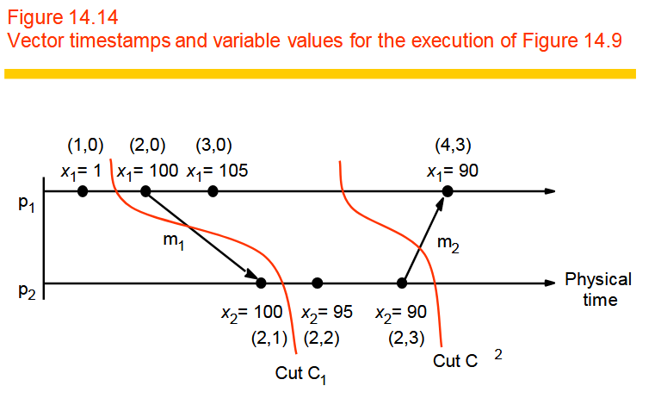
Distributed Debugging

Slide 53
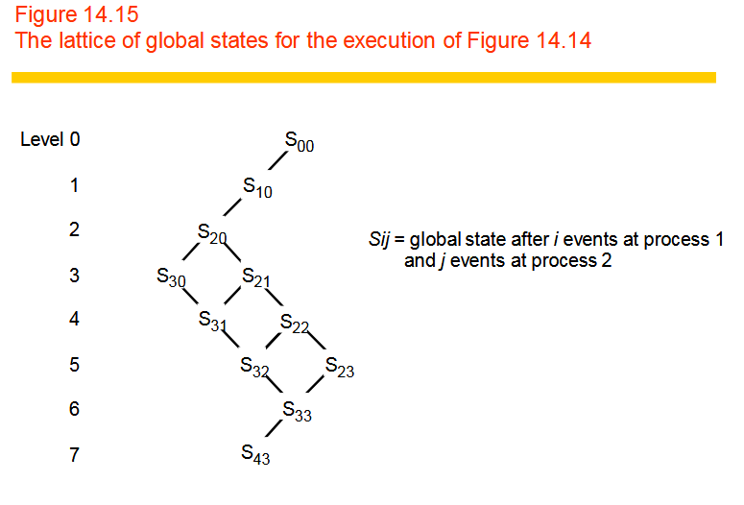

Slide 54
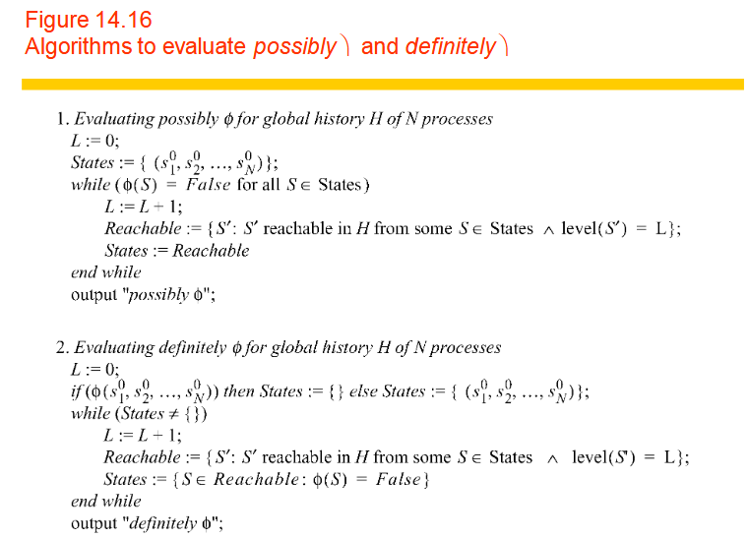

Slide 55
